Slide 1
CS504-Software Engineering – I
VU
Lecture No. 1
Introduction to Software Engineering
An Introduction to Software Construction Techniques for Industrial Strength Software
Introduction
Software engineering is an interesting subject. In order to understand this subject we will need to look at a number of examples and case studies. And we will need to see how we can develop good software and how it could be improved in different scenarios? Before we move on to software engineering we need to understand what software actually is.
What is Software?
When we write a program for computer we named it as software. But software is not just a program; many things other than the program are also included in software.
Some of the constituted items of software are described below.
Program: The program or code itself is definitely included in the software.
Data: The data on which the program operates is also considered as part of the software.
Documentation: Another very important thing that most of us forget is documentation. All the documents related to the software are also considered as part of the software.
So the software is not just the code written in Cobol, Java, Fortran or C++. It also includes the data and all the documentation related to the program.
Why is it important?
Undoubtedly software is playing a vital role in all the field of life these days. We can see many software applications being operated around us in our daily routine.
Some of the major areas in which software has played an important role are identified as under.
Business decision-making: Software systems have played a major role in businesses where you have to analyze your data and on the basis of that analysis you have to make business decisions. This process of data analysis and decision-making has become very accurate and easy by the use of software.
Modern scientific investigation and engineering problem solving: Scientific
investigations and engineering problem solving require an intensive amount of
1
© Copyright Virtual University of Pakistan

Slide 2
CS504-Software Engineering – I VU
calculations and data analysis. The accuracy of these analyses is also very important in scientific applications. This process has become very easy and accurate by the use of software. For example software systems are becoming more involved in bioinformatics and the process of DNA decoding is only possible by the use of software systems. Similarly many astronomical observations are being recorded and analyzed by the software systems these days.
Games: We see many computer games these days that interests people of all ages. All these games are drive through software systems.
Embedded systems: We see many kinds of gadgets being employed in our daily used things, like small microcontrollers used in our cars, televisions, microwave ovens etc. All these systems are controlled through the software.
Similarly in many other fields like education, office automation, Internet applications etc, software is being used. Due to its central importance and massive use in many fields it is contributing a lot in terms of economic activity started by the software products. Billions and trillions of dollars are being invested in this field throughout the world every year.
Engineering
Before moving on to software engineering lets first discuss something about engineering itself. If you survey some of the dictionaries then you will find the following definition of engineering.
“The process of productive use of scientific knowledge is called engineering.”
Difference between Computer Science and Software Engineering
The science concerned with putting scientific knowledge to practical use. Webster’s Dictionary
There are many engineering fields like electrical, mechanical and civil engineering. All these branches of engineering are based on physics. Physics itself is not engineering but the use of physics in making buildings, electronic devices and machines is engineering. When we use physics in constructing buildings then it is called civil engineering. When we use physics in making machines like engines or cars then it is called mechanical engineering. And when we apply the knowledge of physics in developing electronic devices then the process is called electrical engineering. The relation of computer science with software engineering is similar as the relation of physics with the electrical, mechanical or civil engineering or for that matter the relation of any basic science with any engineering field. So in this context we can define software engineering as:
”This is the process of utilizing our knowledge of computer science in effective production of software systems.”
Difference between Software and Other Systems
Now lets talk something about how a software system is different from any other systems. For example, how software is different from a car, a TV or the similar systems or what is the difference between software engineering and other engineering like
2
© Copyright Virtual University of Pakistan

Slide 3
CS504-Software Engineering – I VU
mechanical or electrical engineering. Lets look at some of the non-software systems like TV, Car or an Electric Bulb. The car may be malfunctioned due to some problem in engine while driving. Similarly an electric bulb may be fused while glowing and a TV could be dysfunctional while working.
So the major thing that distinguishes a software system from other systems is that;
“Software does not wear out!”
What does that mean?
As we have seen in above example that our non-software systems could be malfunctioned or crash while working. That mean they are affected by the phenomenon of wear and tear. They have a particular life and after that they could have some problem and may not behave and perform as expected. But this is not the case with software. Software systems does not affect by the phenomenon of wear and tear. If a software has any defect then that defect will be there from the very first day and that defect normally called bug. That means if a software is not working then it should not work from the very first day. But this could not be the case that at a particular point in time a software is functioning well and after some time the same software is not performing the same task as required. So software does not have the element of wear and tear. Lets elaborate this point further. We have just talked about software defects which we call bugs. If a part of a car became wear out you just need to get a new one from market and replace the damages one with the new one. And the car will start working properly as it was working previously. Similarly if an electric bulb got fused then you just need to get a new one and put into the socket in place of the fused one and your room will again be illuminated. But the case of software is somewhat different. If a software has a bug then the same process of replacing faulty part with the new one may not work. You cannot remove the bug by just replacing the faulty part of software with the new one. Or it will not be as simple that, you go to the concerned company, get a new CD of that software and it will start working properly. If the software has a bug and that bug was present in the older CD then that will remain in the new one. This is a fundamental difference between software and other systems.
S1.o3urScoeuorfceInohfeIrnehnetrCenotmCpolemxpitlyexoiftySoofftwSoafrteware
Here the subject is again the same that how software systems are different from other systems. Have you ever noticed that how many different models of a car do a car manufacturing company release in a year? And how many major changes are made in new models and what is the frequency of these changes. If you think a little bit on it then you will realize that once the system is finalized then the changes in new models are of very minor nature. A drastic change is very unlikely in these kinds of systems. So the frequency of changes in these systems is very low and of minor nature. Like body shape could be changed a little, a new gadget could be added and the like but it is very unlikely that a fundamental change in engine is made. On the other hand if you observe the activities of a software manufacturing company, you will realize that these companies make changes of fundamental nature in their software systems. They constantly change their systems whether in the form of enhancements, in the form of interface change or

Slide 4
CS504-Software Engineering – I VU
they are making a new system altogether. In other words they are making changes in their systems in many different dimensions. But in non-software systems these kind of changes are not that much frequent. One of the major reasons of increased bugs in software systems is this high frequency of change. You can well imagine that if a car manufacturing company manufacture cars in the similar way then how long these cars will remain useful, how much effort they have to put to design these cars, how much time they will require to mature the design, and how much time they would be needing to start production of such cars. If they try to cut-short that time, meaning that if they try to release cars after every six-months or a year without proper testing and that release has a fundamental change then that kind of cars will also have lots of bugs and will not be road-worthy.
Therefore one of the major reasons of complexity in software is due to its basic nature that the software passes through a constant process of evolution. The name of the game is change and evolution all the times in all the dimensions. This change has the direct impact on software in the form of defects. Therefore software engineers also have to deals with the challenge of managing this process of change and evolution.
1.34 Software Crisis
What is Software Crisis?
Computer systems were very new and primitive in early fifties and the use of software was also very limited at that time. It was limited to some scientific applications or used to process the data of census. In 1960s a great amount of rapid improvement was made in hardware. New hardware and new computer systems were made available. These computer systems were far more powerful than the computers of early fifties. It is all relative, the computers of 1960s are primitive as compare to the computers we have these days but were far more powerful than the computers of early fifties. More powerful hardware resulted into the development of more powerful and complex software. Those very complex software was very difficult to write. So the tools and techniques that were used for less complex software became inapplicable for the more complex software. Lets try to understand this with the help of an example.
Let’s imagine a person who use to live in a village and who have constructed a hut for him to live. Definitely he should have face some problems in the beginning but was managed to build a hurt for him. Now if you ask him to construct another hut, he may be able to construct one more easily and in a better way. This new hut may be better than the first one and he may construct it in a relatively less time. But if you ask him to construct concrete and iron houses then he may not be able to handle it. Since he made a hut and he know how to make a place to live so you may expect from him to build concrete and iron buildings. If this is the case then you should all agree that the building constructed by that person will not have a stable structure or he may not even be able to build one.
In early 60s software had suffered from the similar kind of problem to which we call Software Crisis. Techniques that were used to develop small software were not applicable for large software systems. This thing resulted in the following consequences.

Slide 5
CS504-Software Engineering – I
VU
In most of the cases that software which was tried to be build using those old tools and techniques were not complete.
Most of the times it was delivered too late.
Most of the projects were over-budgeted.
And in most of the case systems build using these techniques were not reliable – meaning that they were not be able to do what they were expected to do.
As a result of these problems a conference were held in 1960 in which the term software crisis was introduced. And the major issue discussed was that the development of software is in crisis and we have not been able to handle its complexities. And the term of Software Engineering was also coined in the same conference. People have said that, we should use engineering principles in developing software in the same way as we use these principles in developing cars, buildings, electronic devices etc. Software engineering is the result of software crisis when people realized that it is not possible to construct complex software using the techniques applicable in 1960s. An important result of this thing was that people had realized that just coding is not enough.
More Complex Software Applications
This conception is also very common these days. People think that if one knows how to code then that’s sufficient. But just writing code is not the whole story. People have realized this fact way back in 1960s that only coding is not sufficient to develop software systems, we also need to apply engineering principles.
1S.o5ftSwoaftrwe aErnegEinnegeirnienegriansgdaesfidneefdinbeydIbEyEIEE:EE:
Let’s look at some of the definitions of software engineering.
Software Engineering as defined by IEEE (International institute of Electric and Electronic Engineering). IEEE is an authentic institution regarding the computer related issues.
“The application of a systematic, disciplined, quantifiable approach to the development, operation, and maintenance of software; that is, the application of engineering to software.”
Before explaining this definition lets first look at another definition of Software Engineering given by Ian Somerville.
“All aspects of software production’ Software engineering is not just concerned with the technical processes of software development but also with activities such as software project management and with the development of tools, methods and theories to support software production”.
These definitions make it clear that Software Engineering is not just about writing code.
1.5 Software Engineering

Slide 6
CS504-Software Engineering – I VU
1.5 Software Engineering
Software Engineering is the set of processes and tools to develop software. Software Engineering is the combination of all the tools, techniques, and processes that used in software production. Therefore Software Engineering encompasses all those things that are used in software production like:
Programming Language
Programming Language Design
Software Design Techniques
Tools
Testing
Maintenance
Development etc.
So all those thing that are related to software are also related to software engineering.
Some of you might have thought that how programming language design could be related to software engineering. If you look more closely at the software engineering definitions described above then you will definitely see that software engineering is related to all those things that are helpful in software development. So is the case with programming language design. Programming language design is one of the major successes in last fifty years. The design of Ada language was considered as the considerable effort in software engineering.
These days object-oriented programming is widely being used. If programming languages will not support object-orientation then it will be very difficult to implement object-oriented design using object-oriented principles. All these efforts made the basis of software engineering.
Well-Engineered Software
Let’s talk something about what is well-engineered software. Well-engineered software is one that has the following characteristics.
It is reliable
It has good user-interface
It has acceptable performance
It is of good quality
It is cost-effective
Every company can build software with unlimited resources but well-engineered software is one that conforms to all characteristics listed above.
Software has very close relationship with economics. Whenever we talk about engineering systems we always first analyze whether this is economically feasible or not. Therefore you have to engineer all the activities of software development while keeping its economical feasibility intact.

Slide 7
CS504-Software Engineering – I
VU
The major challenges for a software engineer is that he has to build software within limited time and budget in a cost-effective way and with good quality
Therefore well-engineered software has the following characteristics.
Provides the required functionality
Maintainable
Reliable
Efficient
User-friendly
Cost-effective
But most of the times software engineers ends up in conflict among all these goals. It is also a big challenge for a software engineer to resolve all these conflicts.
The Balancing Act!
Software Engineering is actually the balancing act. You have to balance many things like cost, user friendliness, Efficiency, Reliability etc. You have to analyze which one is the more important feature for your software is it reliability, efficiency, user friendliness or something else. There is always a trade-off among all these requirements of software. It may be the case that if you try to make it more user-friendly then the efficiency may suffer. And if you try to make it more cost-effective then reliability may suffer. Therefore there is always a trade-off between these characteristics of software.
These requirements may be conflicting. For example, there may be tension among the following:
Cost vs. Efficiency
Cost vs. Reliability
Efficiency vs. User-interface
A Software engineer is required to analyze these conflicting entities and tries to strike a balance.
Challenge is to balance these requirements.
Software Engineers always confront with the challenge to make a good balance of all these tings depending on the requirements of the particular software system at hand. He should analyze how much weight should all these things get such that it will have acceptable quality, acceptable performance and will have acceptable user-interface.
In some software the efficiency is more important and desirable. For example if we talk about a cruise missile or a nuclear reactor controller that are droved by the software systems then performance and reliability is far more important than the cost-effectiveness and user-friendliness. In these cases if your software does not react within a certain amount of time then it may result in the disaster like Chernobyl accident.

Slide 8
CS504-Software Engineering – I
VU
Therefore software development is a process of balancing among different characteristics of software described in the previous section. And it is an art to come up with such a good balance and that art can be learned from experience.
Law of diminishing returns
In order to understand this concept lets take a look at an example. Most of you have noticed that if you dissolve sugar in a glass of water then the sweetness of water will increase gradually. But at a certain level of saturation no more sugar will dissolved into water. Therefore at that point of saturation the sweetness of water will not increase even if you add more sugar into it.
The law of diminishing act describes the same phenomenon. Similar is the case with software engineering. Whenever you perform any task like improving the efficiency of the system, try to improve its quality or user friendliness then all these things involve an element of cost. If the quality of your system is not acceptable then with the investment of little money it could be improved to a higher degree. But after reaching at a certain level of quality the return on investment on the system’s quality will become reduced. Meaning that the return on investment on quality of software will be less than the effort or money we invest. Therefore, in most of the cases, after reaching at a reasonable level of quality we do not try to improve the quality of software any further. This phenomenon is shown in the figure below.
t
s
o c
cost
benefit
benefit
Software Background
Caper Jones a renounced practitioner and researcher in the filed of Software Engineering, had made immense research in software team productivity, software quality, software cost factors and other fields relate to software engineering. He made a company named Software Productivity Research in which they analyzed many projects and published the results in the form of books. Let’s look at the summary of these results.
He eredlaitveiddeadctsiovfittiwesarientroelaabteodutatcwtievnittiye-sfiivnetodaifbfoeruetnttwceantetyg-ofriivees.dliifsfteerdenint categories tThheeytabhlaevebealnoawly. zTehdeyarohuavned a1n0a0l0y0zesdofatrwoaurnedp1r0o0je0c0tsstooftwcoamree purpojewcittsh to come up wi

Slide 9
CS504-Software Engineering – I VU
such a categorization. But here to cut down the discussion we will only describe nine of them that are listed below.
Project Management
Requirement Engineering
Design
Coding
Testing
Software Quality Assurance
Software Configuration Management
Software Integration and
Rest of the activities
One thing to note here is that you cannot say that anyone of these activities is dominant among others in terms of effort putted into it. Here the point that we want to emphasize is that, though coding is very important but it is not more than 13-14% of the whole effort of software development.
Fred Brook is a renowned software engineer; he wrote a great book related to software engineering named “A Mythical Man Month”. He combined all his articles in this book. Here we will discuss one of his articles named “No Silver Bullet” which he included in the book.
An excerpt from “No Silver Bullet” – Fred Brooks
Of all the monsters that fill the nightmares of our folklore, none terrify more than werewolves, because they transform unexpectedly from the familiar into horrors. For these we seek bullets of silver that can magically lay them to rest. The familiar software project has something of this character (at least as seen by the non-technical manager), usually innocent and straight forward, but capable of becoming a monster of missed schedules, blown budgets, and flawed projects. So we hear desperate cries for a silver bullet, something to make software costs drop as rapidly as computer hardware costs do. Skepticism is not pessimism, however. Although we see no startling breakthroughs, and indeed, such to be inconsistent with the nature of the software, many encouraging innovations are under way. A disciplined, consistent effort to develop, propagate and exploit them should indeed yield an order of magnitude improvement. There is no royal road, but there is a road. The first step towards the management of disease was replacement of demon theories and humors theories by the germ theory. The very first step, the beginning of hope, in itself dashed all hopes of magical solutions. It told workers that progress would be made stepwise, at great effort, and that a persistent, unremitting care would have to be paid to a discipline of cleanliness. So it is with software engineering today.
So, according to Fred Brook, in the eye of an unsophisticated manager software is like a giant. Sometimes it reveals as an unscheduled delay and sometimes it shows up in the form of cost overrun. To kill this giant the managers look for magical solutions. But

Slide 10
CS504-Software Engineering – I VU
unfortunately magic is not a reality. We do not have any magic to defeat this giant. There is only one solution and that is to follow a disciplined approach to build software. We can defeat the giant named software by using disciplined and engineered approach towards software development.
Therefore, Software Engineering is nothing but a disciplined and systematic approach to software development.
1.6 Summary
Today we have discussed the following things related to software engineering.
What is software engineering?
Why is it important?
What is software crisis?
How software engineering derived from software crisis.
What is the importance of engineering principles in developing software?
What is balancing act and how apply in software engineering?
What is law of diminishing returns?
And what are the major activities involved in the development of software.

Slide 11
CS504-Software Engineering – I
VU
Lecture No. 02
Introduction to Software Development
2.1 Software Development
We have seen in our previous discussion that software engineering is nothing but a disciplined approach to develop software. Now we will look at some of the activities involved in the course of software development. The activities involved in software development can broadly be divided into two major categories first is construction and second is management. The construction activities are those that are directly related to the construction or development of the software. While the management activities are those that complement the process of construction in order to perform construction activities smoothly and effectively. A greater detail of the activities involved in the construction and management categories is presented below.
Construction
The construction activities are those that directly related to the development of software,
gathering the requirements of the software, develop design, implement and test the software etc. Some of the major construction activities are listed below.
Requirement Gathering
Design Development
Coding
Testing
Management
Management activities are kind of umbrella activities that are used to smoothly and successfully perform the construction activities e.g. project planning, software quality assurance etc. Some of the major management activities are listed below.
Project Planning and Management
Configuration Management
Software Quality Assurance
Installation and Training
As we have said earlier that management activities are kind of umbrella activities that surround the construction activities so that the construction process may proceed smoothly. This fact is empathized in the figure 1. The figure shows that construction is surrounded by management activities. That is, all construction activities are governed by certain processes and rules. These processes and rules are related to the management of the construction activities and not the construction itself.

Slide 12
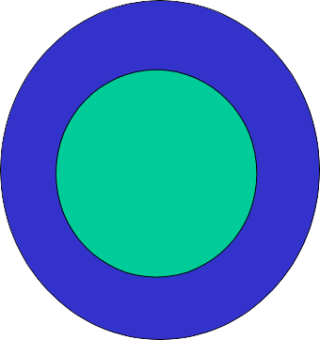
CS504-Software Engineering – I
VU
Project planning and management
Configuration management
Quality assurance
Installation and training
etc.
Management
Construction
Requirements
Design
Coding
Testing
Maintenance etc.
Figure1: Development activities
2.2 A Software Engineering Framework
Any Engineering approach must be founded on organizational commitment to quality. That means the software development organization must have special focus on quality while performing the software engineering activities. Based on this commitment to quality by the organization, a software engineering framework is proposed that is shown in figure 2. The major components of this framework are described below.
Quality Focus: As we have said earlier, the given framework is based on the organizational commitment to quality. The quality focus demands that processes be defined for rational and timely development of software. And quality should be emphasized while executing these processes.
Processes: The processes are set of key process areas (KPAs) for effectively manage and deliver quality software in a cost effective manner. The processes define the tasks to be performed and the order in which they are to be performed. Every task has some deliverables and every deliverable should be delivered at a particular milestone.
Methods: Methods provide the technical “how-to’s” to carryout these tasks. There could be more than one technique to perform a task and different techniques could be used in different situations.
Tools: Tools provide automated or semi-automated support for software processes, methods, and quality control.

Slide 13
CS504-Software Engineering – I
VU
Method
Method
T O O
L S
Task Set
Task Set
Process
Quality Focus
Figure 2: A Software Engineering Framework
S2.o3ftwSoafrtewDareeveDloepvemloepnmt Lenoot pLoop
Lets now look at software engineering activities from a different perspective. Software development activities could be performed in a cyclic and that cycle is called software development loop which is shown in figure 3. The major stages of software development loop are described below.
Problem Definition: In this stage we determine what is the problem against which we are going to develop software. Here we try to completely comprehend the issues and requirements of the software system to build.
Technical Development: In this stage we try to find the solution of the problem on technical grounds and base our actual implementation on it. This is the stage where a new system is actually developed that solves the problem defined in the first stage.
Solution Integration: If there are already developed system(s) available with which our new system has to interact then those systems should also be the part of our new system. All those existing system(s) integrate with our new system at this stage.
Status Quo: After going through the previous three stages successfully, when we actually deployed the new system at the user site then that situation is called status quo. But once we get new requirements then we need to change the status quo.
After getting new requirements we perform all the steps in the software development loop again. The software developed through this process has the property that this could be evolved and integrated easily with the existing systems.

Slide 14
CS504-Software Engineering – I
VU
Problem Definition
Status Quo
Technical Development
Solution Integration
Figure 3: Software Development Loop
Software Construction
Here once again look at the construction activities of the software from a different perspective. This section provides with a sequence of questions that have to answer in different stages of software development.
What is the problem to be solved?
What are the characteristics of the entity that is used to solve the problem?
How will the entity be realized?
How will the entity be constructed?
What approach will be used to uncover errors that were made in the design and construction of the entity?
How will the entity be supported over the long term, when users of the entity request corrections, adaptations, and enhancements?
2.4 Software Engineering Phases
There are four basic phases of software development that are shown in Figure 4.
Vision: Here we determine why are we doing this thing and what are our business objectives that we want to achieve.
Definition: Here we actually realize or automate the vision developed in first phase. Here we determine what are the activities and things involved.
Development: Here we determine, what should be the design of the system, how will it be implemented and how to test it.
Maintenance: This is very important phase of software development. Here we control the change in system, whether that change is in the form of enhancements or defect removel.

Slide 15

CS504-Software Engineering – I
VU
Vision
Definition
Development
Maintenance
Figure 4: Software Engineering Phases
Maintenance
Correction, adaptation, enhancement
For most large, long lifetime software systems, maintenance cost normally exceeds development cost by factors ranging from 2 to 3.
Boehm (1975) quotes a pathological case where the development cost of an avionics system was $30 per line of code but the maintenance cost was $4000 per instruction
2.5 Summary
Software development is a multi-activity process. It is not simply coding.
Software construction and management
Software Engineering Framework
Software development loop
Software engineering phases
Importance of Maintenance

Slide 16
CS504-Software Engineering – I
VU
Lecture No. 3
Requirement Engineering
Requirement Engineering
We recall from our previous discussion that software development is not simply coding – it is a multi-activity process. The process of software construction encompasses and includes answers to the following questions:
What is the problem to be solved?
What are the characteristics of the entity that is used to solve the problem?
How will the entity be realized?
How will the entity be constructed?
What approach will be used to uncover errors that were made in the design and construction of the entity?
How will the entity be supported over the long term when users of the entity request corrections, adaptations, and enhancements?
These questions force us to look at the software development process from different angles and require different tools and techniques to be adopted at different stages and phases of the software development life cycle. Hence we can divide the whole process in 4 distinct phases namely vision, definition, development, and maintenance. Each one of these stages has a different focus of activity. During the vision phases, the focus is on why do we want to have this system; during definition phase the focus shifts from why to what needs to be built to fulfill the previously outlined vision; during development the definition is realized into design and implementation of the system; and finally during maintenance all the changes and enhancements to keep the system up and running and adapt to the new environment and needs are carried out.
Requirement engineering mainly deals with the definition phase of the system. Requirement engineering is the name of the process when the system services and constraints are established. It is the starting point of the development process with the focus of activity on what and not how.
Software Requirements Definitions
Before talking about the requirement process in general and discussing different tools and techniques used for developing a good set of requirements, let us first look at a few definitions of software requirements.
Jones defines software requirements as a statement of needs by a user that triggers the development of a program or system.

Slide 17
CS504-Software Engineering – I VU
Alan Davis defines software requirements as a user need or necessary feature, function, or attribute of a system that can be sensed from a position external to that system.
According to Ian Summerville, requirements are a specification of what should be implemented. They are descriptions of how the system should behave, or of a system property or attribute. They may be a constraint on the development process of the system.
IEEE defines software requirements as:
A condition or capability needed by user to solve a problem or achieve an objective.
A condition or capability that must be met or possessed by a system or system
component to satisfy a contract, standard, specification, or other formally imposed document.
A documented representation of a condition or capability as in 1 or 2.
As can be seen, these definitions slightly differ from one another but essentially say the same thing: a software requirement is a document that describes all the services provided by the system along with the constraints under which it must operate.
3.2 Importance of Requirements
Many of the problems encountered in SW development are attributed to shortcoming in requirement gathering and documentation process. We cannot imagine start building a house without being fully satisfied after reviewing all the requirements and developing all kinds of maps and layouts but when it comes to software we really do not worry too much about paying attentions to this important phase. This problem has been studied in great detail and has been noted that 40-60% of all defects found in software projects can be traced back to poor requirements.
Fred Brooks in his classical book on software engineering and project management “The Mythical Man Month” emphasizes the importance of requirement engineering and writes:
“The hardest single part of building a software system is deciding precisely what to build. No other part of the conceptual work is as difficult as establishing the detailed technical requirements, including all the interfaces to people, to machines, and to other software systems. No other part of the work so cripples the system if done wrong. No other part is more difficult to rectify later.”
Let us try to understand this with the help of an analogy of a house. If we are at an advanced stage of building a house, adding a new room or changing the dimensions of some of the rooms is going to be very difficult and costly. On the other hand if this need is identified when the maps are being drawn, one can fix it at the cost of redrawing the map only. In the case of a software development, we experience the exact same phenomenon - if a problem is identified and fixed at a later stage in the software development process, it will cost much more than if it was fixed at and earlier stage.

Slide 18
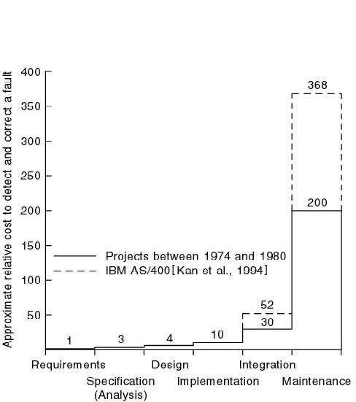
CS504-Software Engineering – I
VU
This following graph shows the relative cost of fixing problem at the various stages of software development.
Boehm (1981) has reported that correcting an error after development costs 68 times more. Other studies suggest that it can be as high as 200 times. Since cost is directly related with the success or failure of projects, it is clear from all this discussion that having sound requirements is the most critical success factor for any project.
3.3 Role of Requirements
Software requirements document plays the central role in the entire software development process. To start with, it is needed in the project planning and feasibility phase. In this phase, a good understanding of the requirements is needed to determine the time and resources required to build the software. As a result of this analysis, the scope of the system may be reduced before embarking upon the software development.
Once these requirements have been finalized, the construction process starts. During this phase the software engineer starts designing and coding the software. Once again, the requirement document serves as the base reference document for these activities. It can be clearly seen that other activities such as user documentation and testing of the system would also need this document for their own deliverables.
On the other hand, the project manager would need this document to monitor and track the progress of the project and if needed, change the project scope by modifying this document through the change control process.

Slide 19
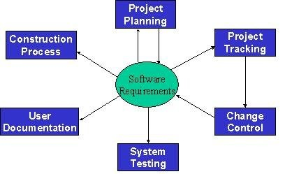
CS504-Software Engineering – I VU
The following diagram depicts this central role of the software requirement document in the entire development process.

Slide 20
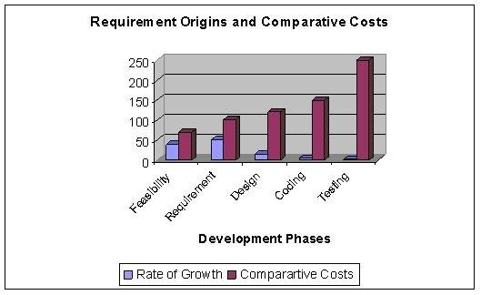
CS504-Software Engineering – I
VU
Lecture No. 4
Requirement Engineering-2
3.4 Some Risks from Inadequate Requirement Process
From the above discussion, it should be clear that the requirements play the most significant role in the software development process and the success and failure of a system depends to a large extent upon the quality of the requirement documents. Following is a list of some of the risks of adopting an inadequate requirement process:
Insufficient user involvement leads to unacceptable products.
If input from different types of user is not taken, the output is bound to lack in key
functional areas, resulting in an unacceptable product. Overlooking the needs of certain user classes (stake holders) leads to dissatisfaction of customers.
Creeping user requirements contribute to overruns and degrade product quality. Requirement creep is one of the most significant factors in budget and time overruns.
It basically means identifying and adding new requirements to the list at some advanced stages of the software development process. The following figure shows the relative cost of adding requirements at different stages.

Slide 21
CS504-Software Engineering – I
VU
Ambiguous requirements lead to ill-spent time and rework.
Ambiguity means that two different readers of the same document interpret the requirement differently. Ambiguity arises from the use of natural language. Because of the imprecise nature of the language, different readers interpret the statements differently. As an example, consider the following Urdu Phrase: “Rooko mut jane doo”. Now, depending upon where a reader places the comma in this statement, two different readers may interpret it in totally different manner. If a comma is palced after “Rooko”, the sentence will become “Rooko, mut jane doo”, meaning “don’t let him go”. On the other hand if the comma id placed after “mut”, the sentence will become “Rooko mut, jane doo”, meaning “let him go”. Ambiguous requirements therefore result in misunderstandings and mismatched expectations, resulting in a wasted time and effort and an undesirable product.
Let us consider the following requirement statement:
The operator identity consists of the operator name and password; the password consists of six digits. It should be displayed on the security VDU and deposited in the login file when an operator logs into the system.
This is an example of ambiguous requirement as it is not clear what is meant by “it” in the second sentence and what should be displayed on the VDU. Does it refer to the operator identity as a whole, his name, or his password?
Gold-plating by developers and users adds unnecessary features.
Gold-plating refers to features are not present in the original requirement document and in fact are not important for the end-user but the developer adds them anyway thinking that they would add value to the product. Since these features are outside the initial scope of the product, adding them will result in schedule and budget overruns.
2_1
© Copyright Virtual University of Pakistan

Slide 22
CS504-Software Engineering – I
VU
Minimal specifications lead to missing key requirements and hence result in an unacceptable product.
As an example, let us look at the following requirement. The requirement was stated as: “We need a flow control and source control engineering tool.” Based upon this requirement, system was built. It worked perfectly and had all the functionality needed for source control engineering tool and one could draw all kinds of maps and drawings. The system however could not be used because there was there was no print functionality.
Let us now look at the following set of requirement statements for another system:
The system should maintain the hourly level of reservoir from depth sensor situated in the reservoir. The values should be stored for the past six months.
AVERAGE: Average command displays the average water level for a particular sensor between two times.
This is another case of minimal requirements – it does not state how the system
should respond if we try to calculate the average water level beyond the past six months.
6. Incompletely defined requirements make accurate project planning and tracking impossible.
Levels of Software Requirements
Software requirements are defined at various levels of detail and granularity. Requirements at different level of detail also mean to serve different purposes. We first look at these different levels and then will try to elaborate the difference between these with the help of different examples.
1. Business Requirements:
These are used to state the high-level business objective of the organization or customer requesting the system or product. They are used to document main system features and functionalities without going into their nitty-gritty details. They are captured in a document describing the project vision and scope.

Slide 23
CS504-Software Engineering – I
VU
User Requirements:
User requirements add further detail to the business requirements. They are called user requirements because they are written from a user’s perspective and the focus of user requirement describe tasks the user must be able to accomplish in order to fulfill the above stated business requirements. They are captured in the requirement definition document.
Functional Requirements:
The next level of detail comes in the form of what is called functional requirements. They bring-in the system’s view and define from the system’s perspective the software functionality the developers must build into the product to enable users to accomplish their tasks stated in the user requirements - thereby satisfying the business requirements.
Non-Functional Requirements
In the last section we defined a software requirement as a document that describes all the services provided by the system along with the constraints under which it must operate. That is, the requirement document should not only describe the functionality needed and provided by the system, but it must also specify the constraints under which it must operate. Constraints are restrictions that are placed on the choices available to the developer for design and construction of the software product. These
kinds of requirements are called Non-Functional Requirements. These are used to describe external system interfaces, design and implementation constraints, quality and performance attributes. These also include regulations, standards, and contracts to which the product must conform.
Non-functional requirement play a significant role in the development of the system. If not captured properly, the system may not fulfill some of the basic business needs. If proper care is not taken, the system may collapse. They dictate how the system architecture and framework. As an example of non-functional requirements, we can require software to run on Sun Solaris Platform. Now it is clear that if this requirement was not captured initially and the entire set of functionality was built to run on Windows, the system would be useless for the client. It can also be easily seen that this requirement would have an impact on the basic system architecture while the functionality does not change.
While writing these requirements, it must always be kept in mind that all functional requirements must derive from user requirements, which must themselves be aligned with business requirements. It must also be remembered that during the requirement engineering process we are in the definition phase of the software development where the focus is on what and not how. Therefore, requirements must not include design or implementation details and the focus should always remain on what to build and not how to build.

Slide 24
CS504-Software Engineering – I VU
Let us now look at an example to understand the difference between these different types of requirements.
Let us assume that we have a word-processing system that does not have a spell checker. In order to be able to sell the product, it is determined that it must have a spell checker. Hence the business requirement could be stated as: user will be able to correct spelling errors in a document efficiently. Hence, the Spell checker will be included as a feature in the product.
In the next step we need to describe what tasks must be included to accomplish the above-mentioned business requirement. The resulting user requirement could be as follows: finding spelling errors in the document and decide whether to replace each misspelled word with the one chosen from a list of suggested words. It is important to note that this requirement is written from a user’s perspective.
After documenting the user’s perspective in the form of user requirements, the system’s perspective: what is the functionality provided by the system and how will it help the user to accomplish these tasks. Viewed from this angle, the functional requirement for the same user requirement could be written as follows: the spell checker will find and highlight misspelled words. It will then display a dialog box with suggested replacements. The user will be allowed to select from the list of suggested replacements. Upon selection it will replace the misspelled word with the selected word. It will also allow the user to make global replacements.
Finally, a non-functional requirement of the system could require that it must be integrated into the existing word-processor that runs on windows platform.
Stakeholders
As mentioned earlier, in order to develop a good requirement document, it is imperative to involve all kinds of user in the requirement engineering process. The first step in fulfillment of this need is the identification of all the stakeholders in the system. Stakeholders are different people who would be interested in the software. It is important to recognize that management carries a lot of weight, but they usually are not the actual users of the system. We need to understand that it is the actual user who will eventually use the system and hence accept or reject the product. Therefore, ignoring the needs of any user class may result in the system failure.
A requirement engineer should be cognizant of the fact that stakeholders have a tendency to state requirements in very general and vague terms. Some times they trivialize things. Different stakeholders have different requirements – sometimes even conflicting. On top of that internal politics may influence requirements.
The role of stakeholders cannot be overemphasized. A study of over 8300 projects revealed that the top two reasons for any project failure are lack of user input and incomplete requirements.
The following diagram shows the role of different stakeholders in the setting the system requirements.

Slide 25
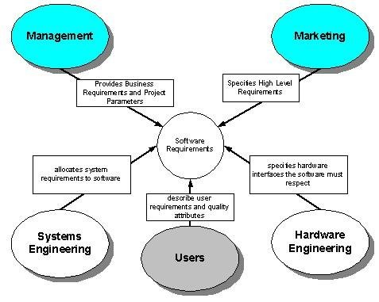
CS504-Software Engineering – I
VU
Requirement
Documents
Statement
and Requirement
Specification
Different levels of software requirements are documented in different documents. The two main documents produced during this phase are Requirement Statement and Requirement Specification. They are also called Requirement Definition and Functional Specification and are used to document user requirements and functional requirements respectively.
Requirement Statement Characteristics
A good Requirements statement document must possess the following characteristics.
Complete - Each requirement must fully describe the functionality to be delivered.
Correct - Each requirement must accurately describe the functionality to be built.
Feasible - It must be possible to implement each requirement within the known capabilities and limitations of the system and its environment.

Slide 26
CS504-Software Engineering – I
VU
Necessary -Each requirement should document something that the customer really need or something that is required for conformance to an external system requirement or standard.
Prioritized - An implementation priority must be assigned to each requirement, feature or use case to indicate how essential it is to a particular product release.
Unambiguous - All readers of a requirement statement should arrive at a single, consistent interpretation of it.
Verifiable – User should be able to devise a small number of tests or use other verification approaches, such as inspection or demonstration, to determine whether the requirement was properly implemented.
Requirement Specification Characteristics
A good Requirements specification document should possess the following characteristics.
Complete - No requirement or necessary information should be missing.
Consistent – No requirement should conflict with other software or higher-level system or business requirements.
Let us try to understand this with the help of some examples. The following set of (non-functional) requirements was stated for a particular embedded system.
All programs must be written in Ada
The program must fit in the memory of the embedded micro-controller
These requirements conflicted with one another because the code generated by the Ada compiler was of a large footprint that could not fit into the micro-controller memory.
Following is another set of (functional) requirements that conflicted with one another:
System must monitor all temperatures in a chemical reactor.

Slide 27
CS504-Software Engineering – I
VU
System should only monitor and log temperatures below -20⁰ C and above 400⁰ C.
In this case the two requirements clearly conflict with each other in stating what information needs to be monitored and stored.
Modifiable - One must be able to revise the Software Requirement Specification when necessary and maintain a history of changes made to each requirement.
Traceable - One should be able to link each requirement to its origin and to the design elements, source code, and test cases that implement and verify the correct implementation of the requirement.
Mixed level of Abstraction
It is important to recognize that all requirements in a requirement document are stated at a uniform level of abstraction. This difference in detail falsely implies the relative importance of these requirements and hence misguides all involved in the development process. The following set of requirements clearly demonstrates violation of this principle:
The purpose of the system is to track the stock in a warehouse.
When a loading clerk types in the withdraw command he or she will communicate the order number, the identity of the item to be removed, and the quantity removed. The system will respond with a confirmation that the removal is allowable.

Slide 28
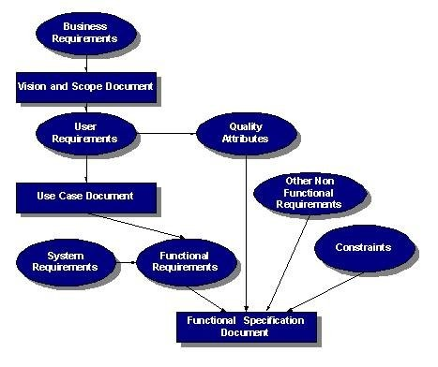
CS504-Software Engineering – I
VU
Lecture No. 5
of Several components
Relationship Requirements
of Software
The following figure depicts the relationship between different documents produced during the requirement engineering phase.

Slide 29
CS504-Software Engineering – I
VU
Business Requirements
Business requirements collected from multiple sources might conflict. For example, consider a kiosk product with embedded software that will be sold to retail stores and used by the store’s customers. The kiosk developer’s business objectives include the following:
leasing or selling the kiosk to the retailers
selling consumables through the kiosk to the customer
attracting customer to the brand
modifying the nature of the historical developer-customer relationship
The retailer’s business interest could include:
making money from customer use of kiosk
attracting more customers to the store
saving money if the kiosk replaces manual operations
The developer might want to establish a high-tech and exciting new direction for customers, while the retailer wants a simple solution and the customer wants convenience and features. The tension among these three parties with their different goals, constraints, and cost factors can lead to conflicting business requirements, which must be resolved
before the kiosk’s software requirements are detailed.
You can also use the business requirements to set implementation priorities for use cases and their associated functional requirements. For example, a business requirement to generate maximum revenue from the kiosk would imply the early implementation of features directly associated with selling more products or services to the customer, rather than glitzy features that appeal to only a subset of customers.
The Vision Statement
The vision statement should reflect a balanced view that will satisfy the need of diverse customers. It can be somewhat idealistic but should be grounded in the realities of existing or anticipated customer markets, enterprise architectures, organizational strategic directions, and resource limitations.

Slide 30
CS504-Software Engineering – I
VU
Chemical Tracking System
The chemical tracking system will allow scientists to request containers of chemicals to be supplied by chemical stockroom or by vendors. The location of every chemical container within the company, the quantity of the material remaining in it, and the complete history of each container’s location and usage will be known by the system at all times. The company will save 25% on chemical costs by fully exploiting chemicals already available within the company, by disposing of fewer partially used or expired containers, and by using a standard chemical purchasing process. The chemical tracking system will also generate all reports required to comply with federal and state government regulations that require the reporting of chemical usage, storage, and disposal.
Assumptions and Dependencies
All assumptions that were made when conceiving the project have to be recorded. For example, the management sponsor for the chemical tracking system assumed that it would replace the existing chemical stockroom inventory system and that it would interface to the appropriate purchasing department applications
Scope
Project scope defines the concept and range of the proposed solution, and limitations identify certain capabilities that the product will not include. Clarifying the scope and limitations helps to establish realistic stakeholder’s expectations. Sometimes customers request features that are too expansive or do not lie within the intended project scope. Propose requirements that are out of scope must be rejected, unless they are so beneficial that the scope should be enlarged to accommodate them (with accompanying changes in budget, schedule, and staff). Keep a record of these requirements and why they were rejected, as they have a way of reappearing.
Scope and Initial Release
The major features that will be included in the initial release of the project should be summarized. Describe the quality characteristics that will enable the product to provide the intended benefits to its various customer communities.
Requirements need to be prioritized and a release schedule should be made.

Slide 31
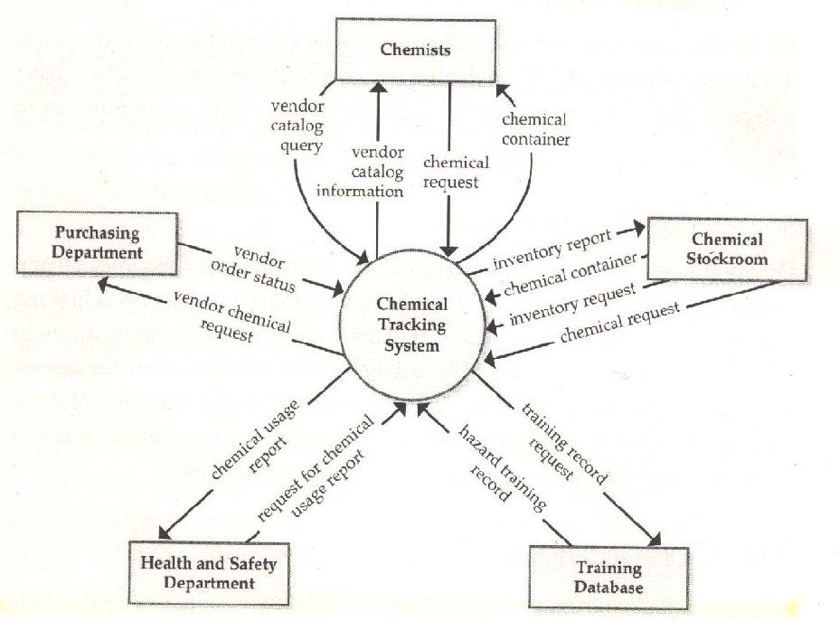
CS504-Software Engineering – I
VU
The Context Diagram
The scope description establishes the boundary between the system we are developing and everything else in the universe. The context diagram graphically illustrates this boundary by showing the connections between the system being developed or the problem being addressed, and the outside world. The context diagram identifies the entities outside the system that interface to it in some way (called terminators or external entities), as well as the flow of data and material between each external entity and the system. The context diagram is used as the top level abstraction in a dataflow diagram developed according to principles of structured analysis. The context diagram can be included in the vision and scope document, in the SRS, or as part of a dataflow model of the system.
Following is a context diagram of the chemical tracking system.

Slide 32
CS504-Software Engineering – I
VU
Use Cases and Customer-Developer Relationship
It has been mentioned earlier on, excellent software products are the result of a well- executed design based on excellent requirements and high quality requirements result from effective communication and coordination between developers and customers. That is, good customer-developer relationship and effective communication between these two entities is a must for a successful software project. In order to build this relationship and capture the requirements properly, it is essential for the requirement engineer to learn about the business that is to be automated.
It is important to recognize that a software engineer is typically not hired to solve a computer science problem – most often than not, the problem lies in a different domain than computer science and the software engineer must understand it before it can be solved. In order to improve the communication level between the vendor and the client, the software engineer should learn the domain related terminology and use that terminology in documenting the requirements. Document should be structured and written in a way that the customer finds it easy to read and understand so that there are no ambiguities and false assumption.
One tool used to organize and structure the requirements is such a fashion is called use case modeling.
It is modeling technique developed by Ivar Jacobson to describe what a new system should do or what an existing system already does. It is now part of a standard software modeling language known as the Unified Modeling Language (UML). It captures a discussion process between the system developer and the customer. It is widely used because it is comparatively easy to understand intuitively – even without knowing the notation. Because of its intuitive nature, it can be easily discussed with the customer who may not be familiar with UML, resulting in a requirement specification on which all agree.
3.8 Use Case Model Components
A use case model has two components, use cases and actors.
In a use case model, boundaries of the system are defined by functionality that is handled by the system. Each use case specifies a complete functionality from its initiation by an actor until it has performed the requested functionality. An actor is an entity that has an interest in interacting with the system. An actor can be a human or some other device or system.
A use case model represents a use case view of the system – how the system is going to be used. In this case system is treated as a black box and it only depicts the external interface of the system. From an end-user’s perspective it and describes the functional requirements of the system. To a developer, it gives a clear and consistent description of what the system should do. This model is used and elaborated throughout the development process. As an aid to the tester, it provides a basis for performing system tests to verify the system. It also provides the ability to trace functional requirements into actual classes and operations in the system and hence helps in identifying any gaps.

